Slide 1

Module 1 – SMA-X User Interfaces
Jan 2018
Notes:
[STANDARD SLIDE: L300 (animated)]
You can change out the photo with any image from Getty Images in DropBox.
If the main title is shorter, you can make the font larger.
You may have to move the title text around depending on the photo. Make sure the text is readable against the background photo.
You can change the background color for the rectangle in the bottom-right corner to look better against the background. Choose a Micro Focus color at 25% transparency.
=========================
Note to Narrator or Reader: [PRESS] indicates press the Page Down key to show the animation
=========================
Hello and Welcome to the [COURSE_NAME] Technical Overview Training, Level 300.
In this course you’ll gain a high-level understanding of the essentials of [PRODUCT_NAME].
[PRESS] If you want to download this presentation and save it on your own system, click the Tools & Help icon in the bottom-right corner of your window and select Download.
Or, if you want to access the PPT slides and speaker notes for future reference, go to the Attachments tab in your window click to download the presentation.

Slide 2
Objectives
After completing this module, you should be able to:
Describe the features of the SMA Service Portal and mobile interfaces
Describe the features of the SMA-X Agent interface
Understand Tasks and Task/Approval Plans

Slide 3
SMA Service Portal

Slide 4
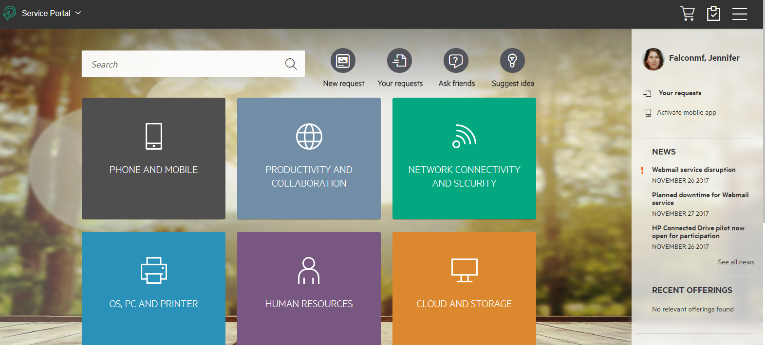
SMA Service Portal
Shopping Cart
Notifications
Self-Service reduces ticket volume and increase user satisfaction
Search for News, catalog offerings, and knowledge articles
Catalog offerings

Slide 5
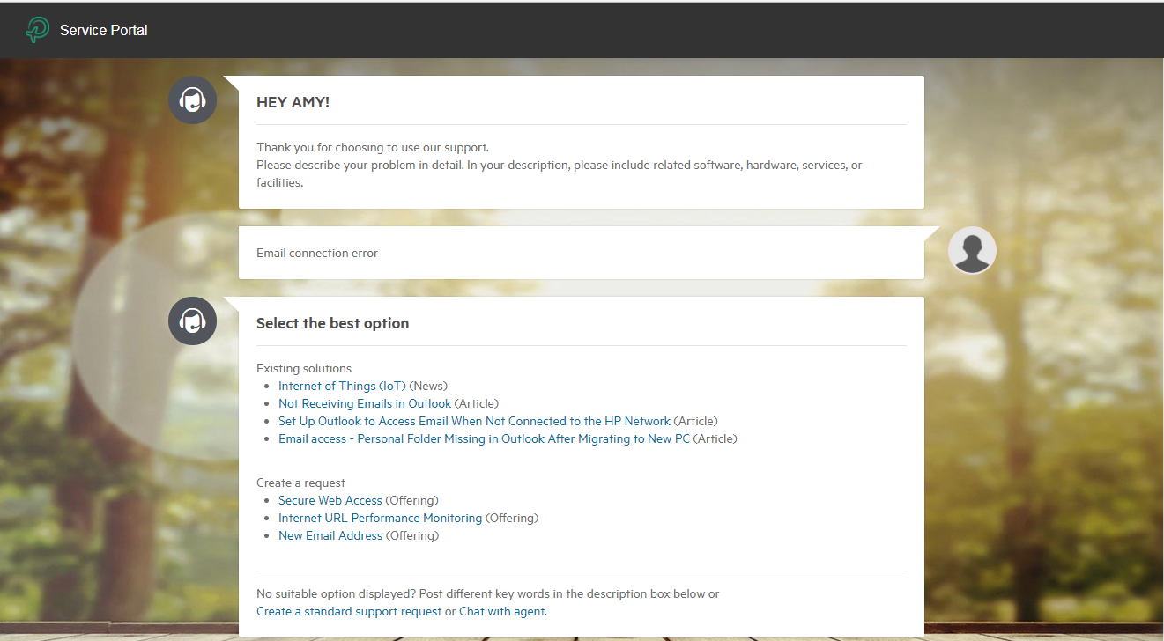
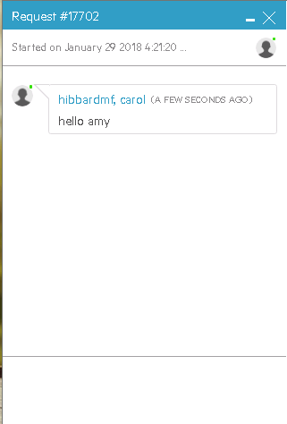
Chat with virtual or real agent
Natural language interactions
Recommendations from Virtual Agent
Chat with Live Agent
Chat with Live Agent

Slide 6
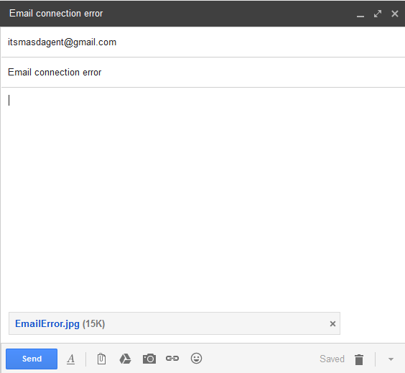
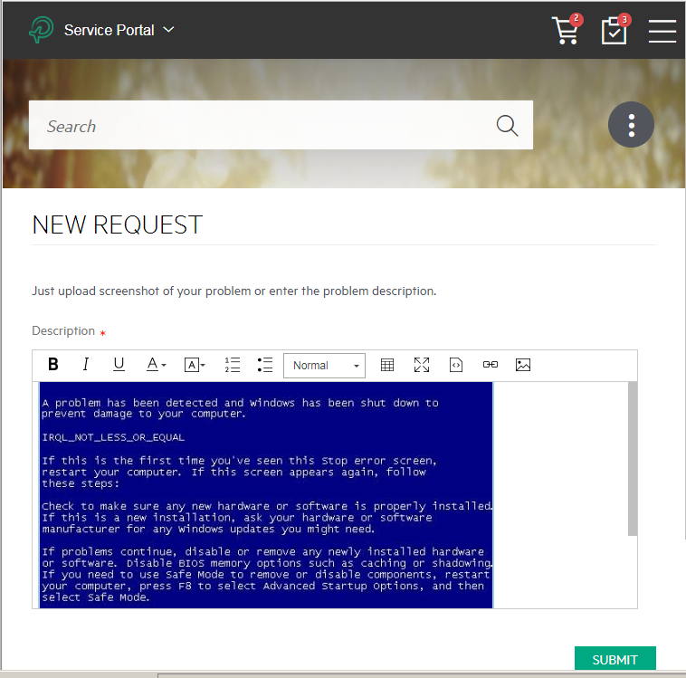
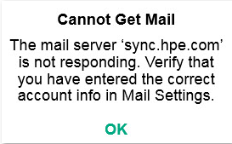
Smart Ticket OCR feature
A superior user experience, better call routing, quicker resolution time
Attaching a screenshot to an email or drag/drop to a support request in the portal is all that is needed to create a new incident. The SMA system will parse the picture and capture key information to populate all related fields.

Slide 7
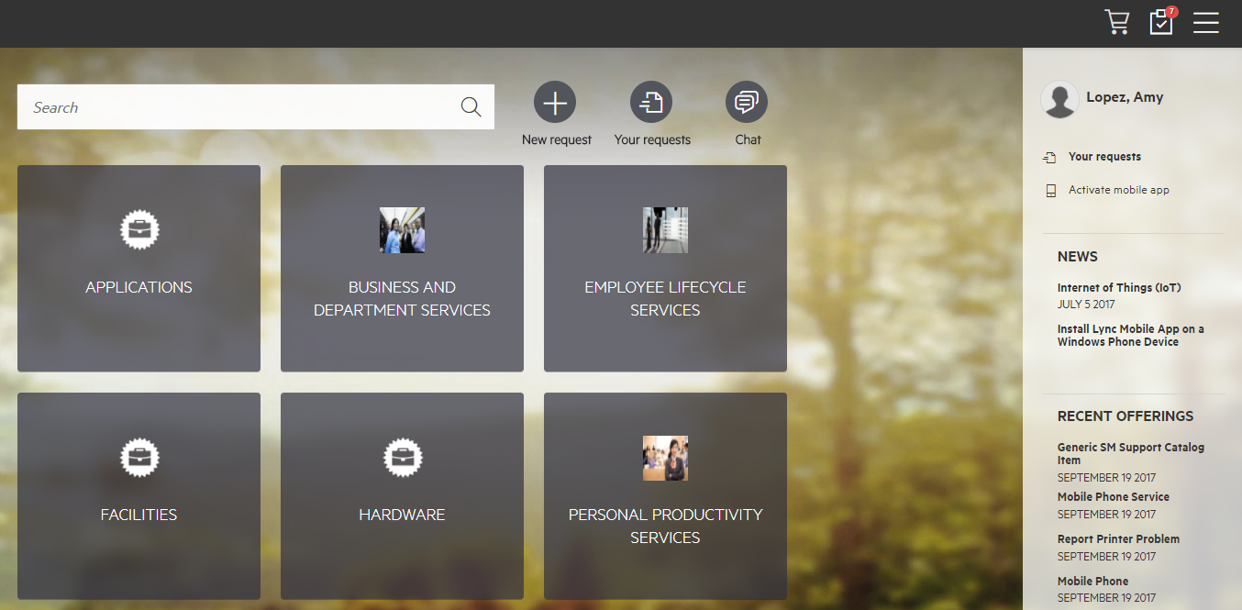
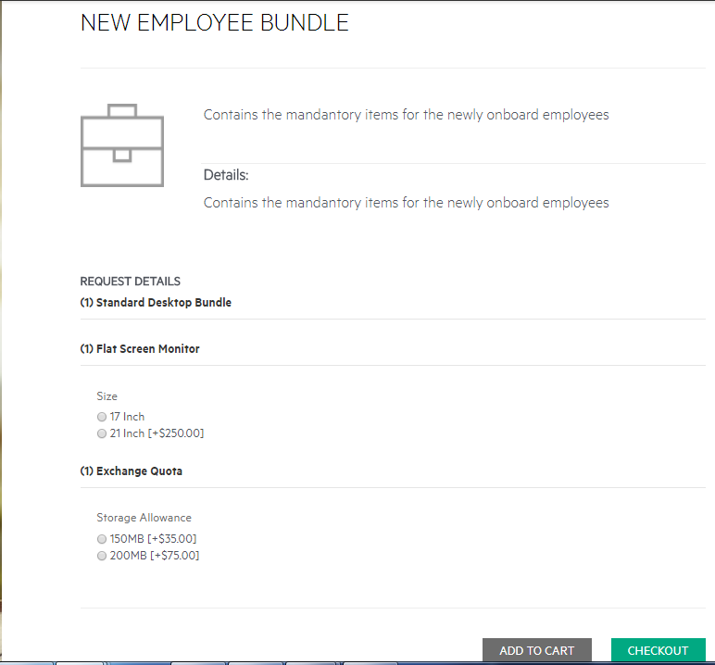
Shop
Chat with Live Agent
Search or Browse Catalog
Recent offerings
Dynamic user options

Slide 8
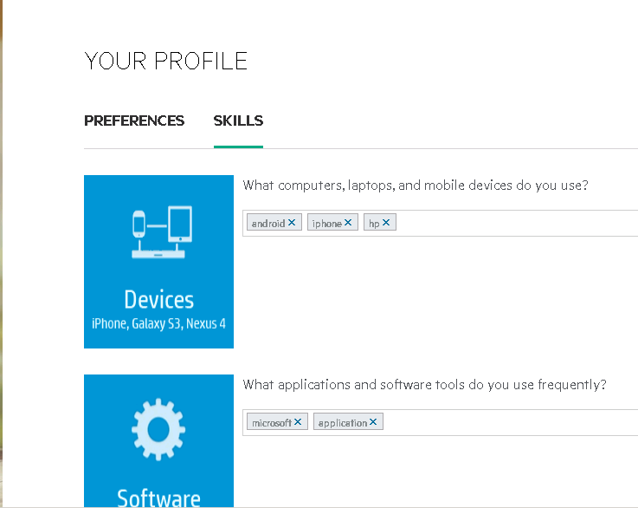
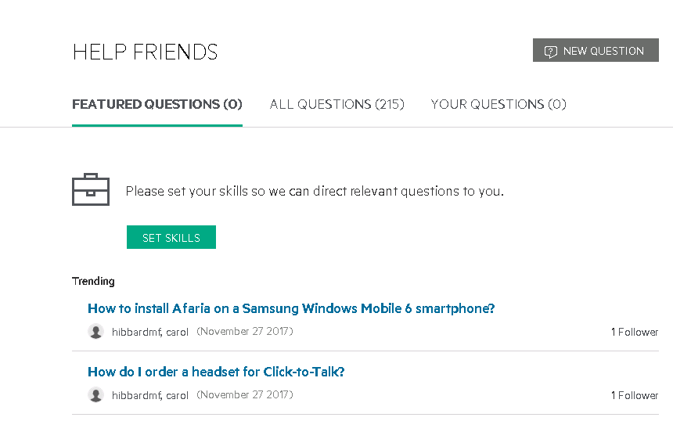
Ask Friends/Help Friends
Engaging and fun
IT still controls
Business Community
Users can define profiles of expertise
Profiles are further enhanced each time a user answers a question or works on a certain problem ticket
Search Based Matching
Forum posts are matched with Expert Profiles
Experts are proactively sent requests to help out

Slide 9

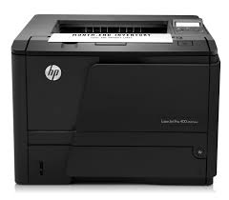



Public Requests
Help! Printer is jammed
Shared Visibility
Enable expanded visibility for requests for specific offerings. For example:
Support for Shared Printer issues may be visible by users in the same location
Application Performance issues may be visible by users in the same organization
“Me Too!”
When users report an issue, they are presented with similar visible support requests
Instead of opening a new ticket, a user may sign onto a public/social ticket, add comments and receive tracking notification
Is the Payroll portal is down?
User A
Location Shared Device
Organization Shared Application
User B
User C
Me too! I have the same problem
I just got help unjamming the printer. Try it now ☺
Notes:
Customer can define for any offering if it’s can generate public requests. Values are Always (all requests for the offering are public), Never (no request for this offering is public) or user-defined. For Always and user defined, the default public scope is determined by the offering default values. For user-defined, the user can change the values during the request opening procedure.
Agents can set the values on the request manually.
Users can find open or recently closed public requests (up to 3 weeks of opening) when searching ESS.
Users will have a list/tab of public requests in the request list page
Users can register to track a public request – they will have a tab in request list page to show all tracked requests
Support agent can manually add users to the list of followers of the request
Users will receive comment and solution updates on their tracked requests and can add their own comments from ESS or by email integration
The requestor will be notified on new comments from other end users and can mark the comment (from mail and UI) as the comment that was the solution to his issue.

Slide 10
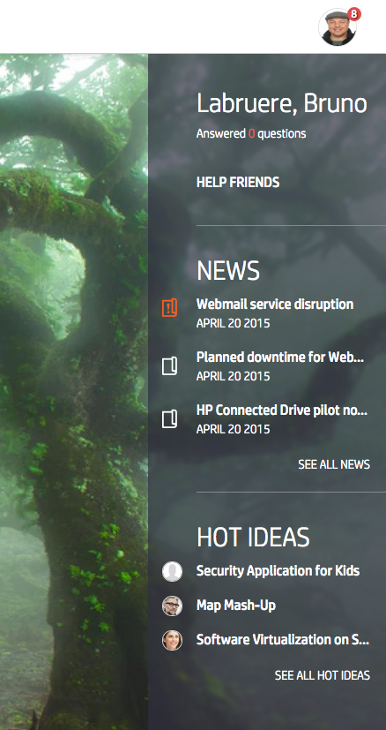
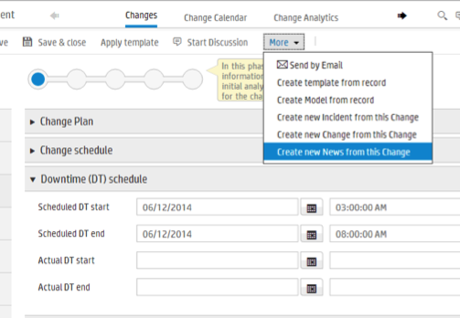
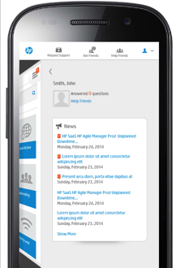
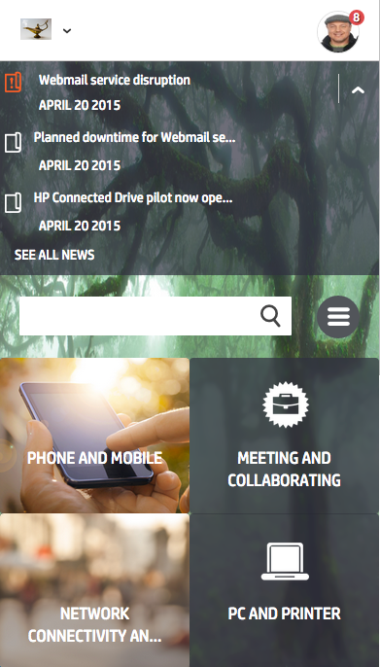
IT News
New functionality for Business and Service Desk users
Self Service targeted News
Push news to users via Self-Service Portal on web and mobile
Segment news by location/group entitlements
See news relevant to service and support context
News Publishing
News publication lifecycle
Publish news from Incident, Change, or Service Catalog

Slide 11
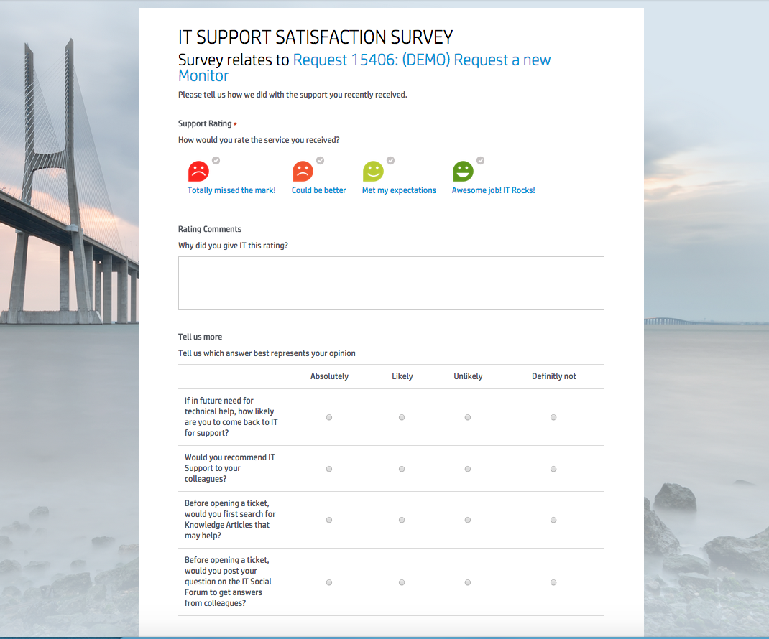
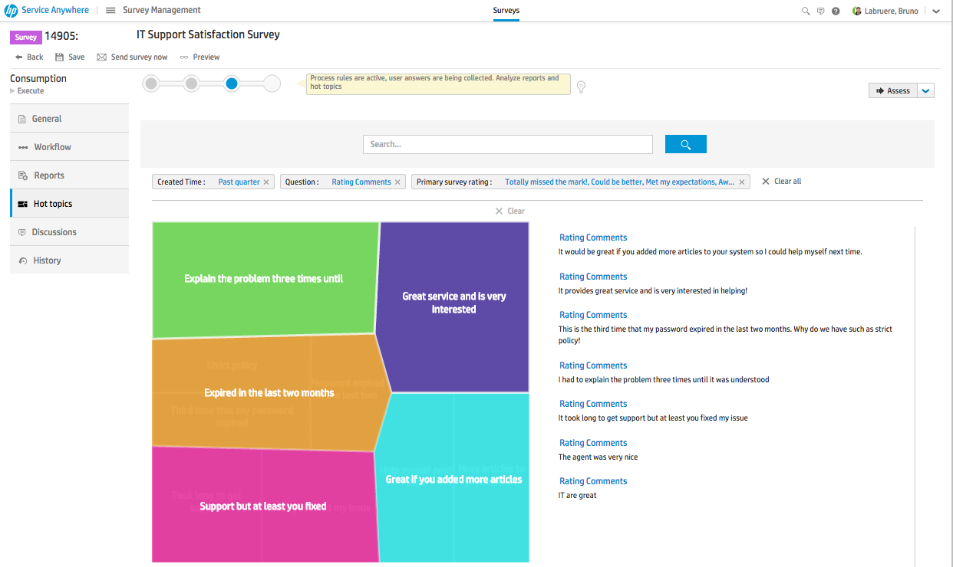
Surveys
Improve customer satisfaction
Survey Management
Define surveys related to any process: Satisfaction surveys for Service, Support, Asset model, Post-Change success survey, Application utilization, proposal surveys, etc …
Collect Responses Effectively
Friendly formats designed to increase user response rates
Big Data Analytics
Hot topic analysis of responses
Full reporting and dashboarding capabilities

Slide 12
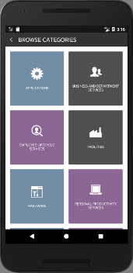


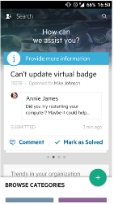

Mobile Self-Service
Search knowledge or catalog, Create service or support request, Approve
Browse the catalog, quick pick from the most popular
Search for offerings, articles and view mobile-optimized knowledge articles
Request a catalog item
Proactive notifications when approvals are pending (android)
The mobile application allows access to SMA without having to be at your desk
Notes:
Browse catalog and knowledge
View and track my currently open requests
Search for offerings, articles and view details
Browse the catalog, quick pick from the most popular
Request a catalog item
Self Service Options
Search the knowledge base, view mobile-optimized knowledge articles
Approvals
Proactive notifications when approvals are pending
Android version will be available first, followed by iOS (POC happening now)
The mobile app will be available on Google Play or through direct apk distribution

Slide 13
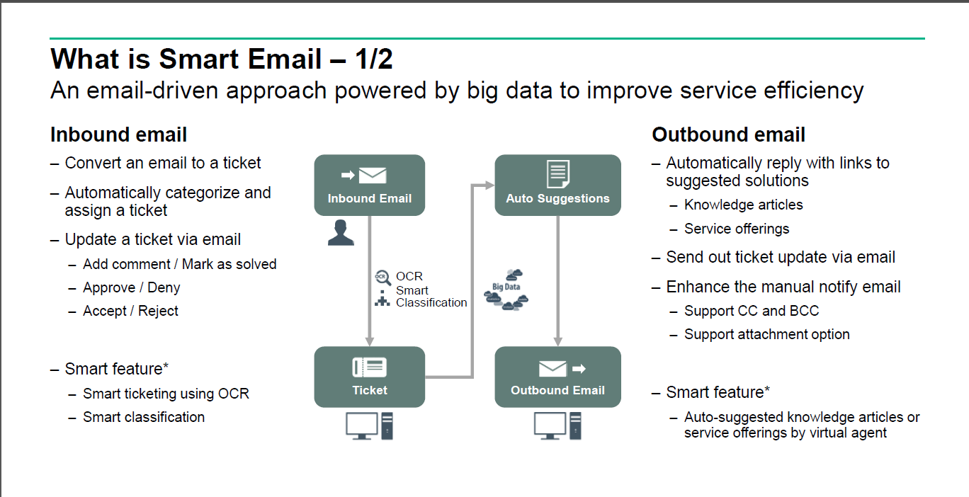
Smart Email
Smart E-mail
–Hot topic analytics for email tickets
–Email archiving
–KPIs for email tickets

Slide 14
Self-Service Interfaces Feature Summary
 | SM Service Portal | Smart Email | Mobility ESS | ESS Web | SRC | SMA Service Portal | SMA Mobile app
Global Search | X | X |  |  | X | X | X
KM Search | X | X³ | X | X | X | X | X
Create/view/add comments on a request | X | X | X | X | X | X | X
Create a SMART request | X | X | X | X | X | X | X
Order from catalog | X | X³ |  | X | X | X | X
Approvals | X¹ | X | X | X | X² | X² | X⁵
Subscriptions |  |  |  | X | X | X⁴
Chat | X | X via emails |  | X |  | X
Survey | X | X³ |  | X | X | X
1 – SM 9.50 Interaction only. SM 9.51 or later: Interaction and Change approvals
2 – Approval delegation supported
3 – Email response from virtual agent includes link to portal
4 – CSA subscriptions only with SMA-SM only, SMA-X subscriptions with SMA-X
5 – SM Interactions (9.50 and later) and SM Change (9.52 or later) or SMA-X Service Requests only

Slide 15
Agent IT Interface

Slide 16
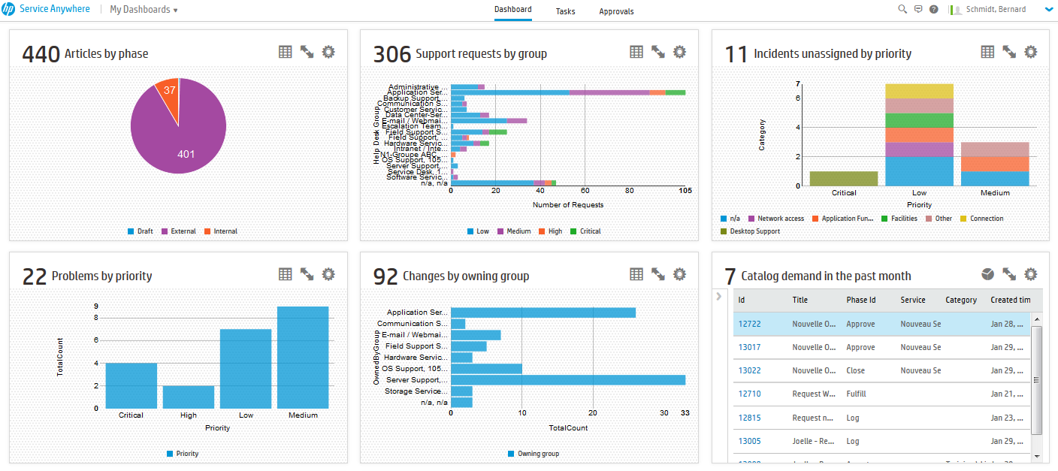
Navigating the IT Agent Interface
When you log into IT Agent interface, the Dashboard is your Landing Page.
Service Management
Click on the Service Management button from anywhere to go back to Dashboard
From the Dashboard, you can go to your Tasks and your Approvals

Slide 17
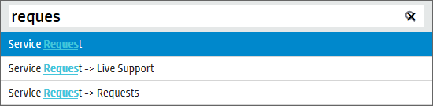
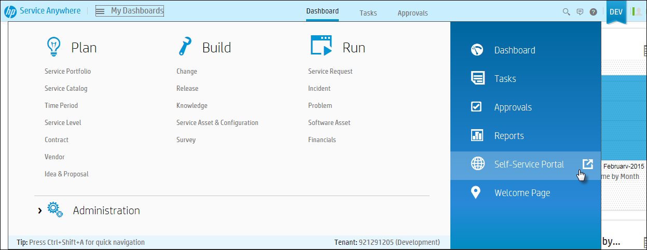
Navigating the IT Agent Interface
Press Ctrl + Shift + A for quick navigation
Main Menu (Mega Menu)
Click Main Menu button
Service Management

Slide 18
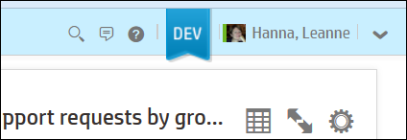
Navigating the IT Agent Interface
Context Sensitive Help
Logout or About screen
Buttons in navigation tray
Global Search
Discussions List
Context Sensitive Help
Tenant type banner
Logged on agent
Log Out
Global Search
Start a live discussion on the current record
Avatar of the signed in user

Slide 19
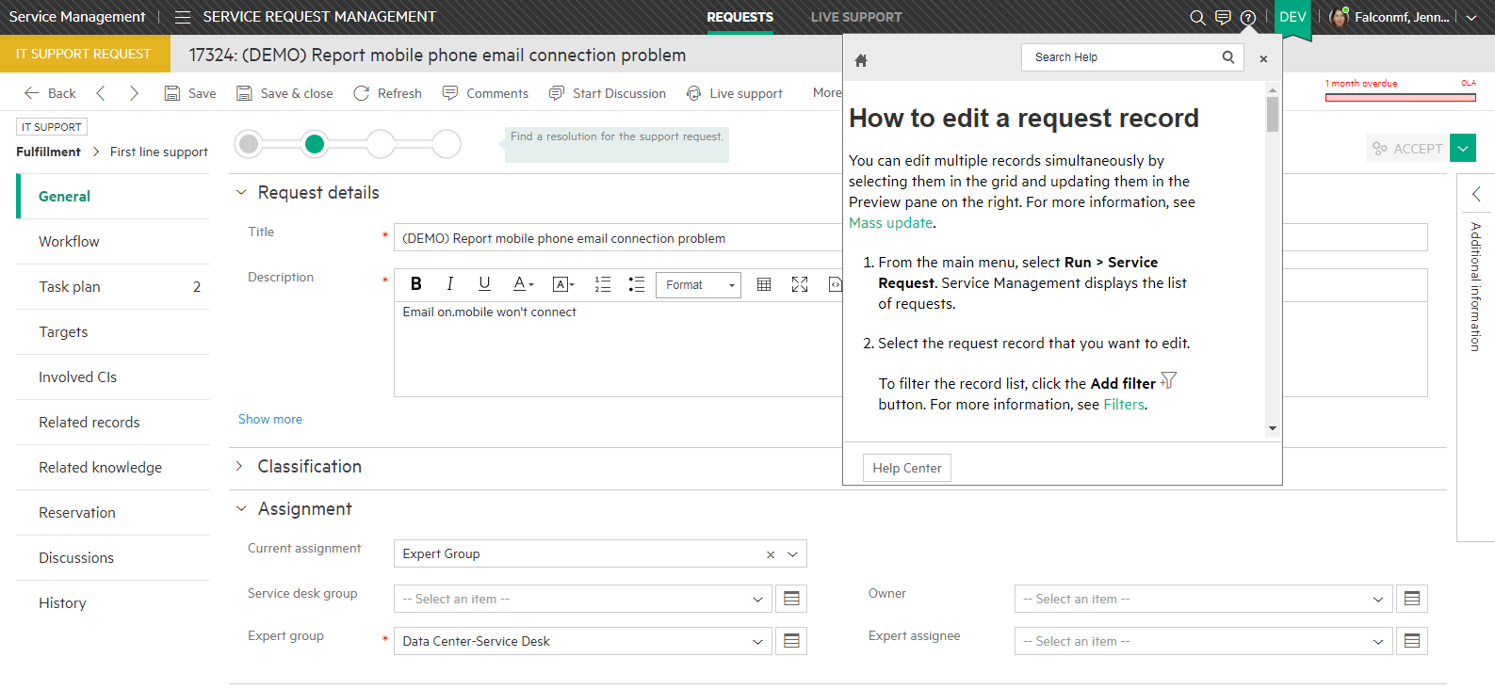
Online Help in agent interface
Context-sensitive online help

Slide 20
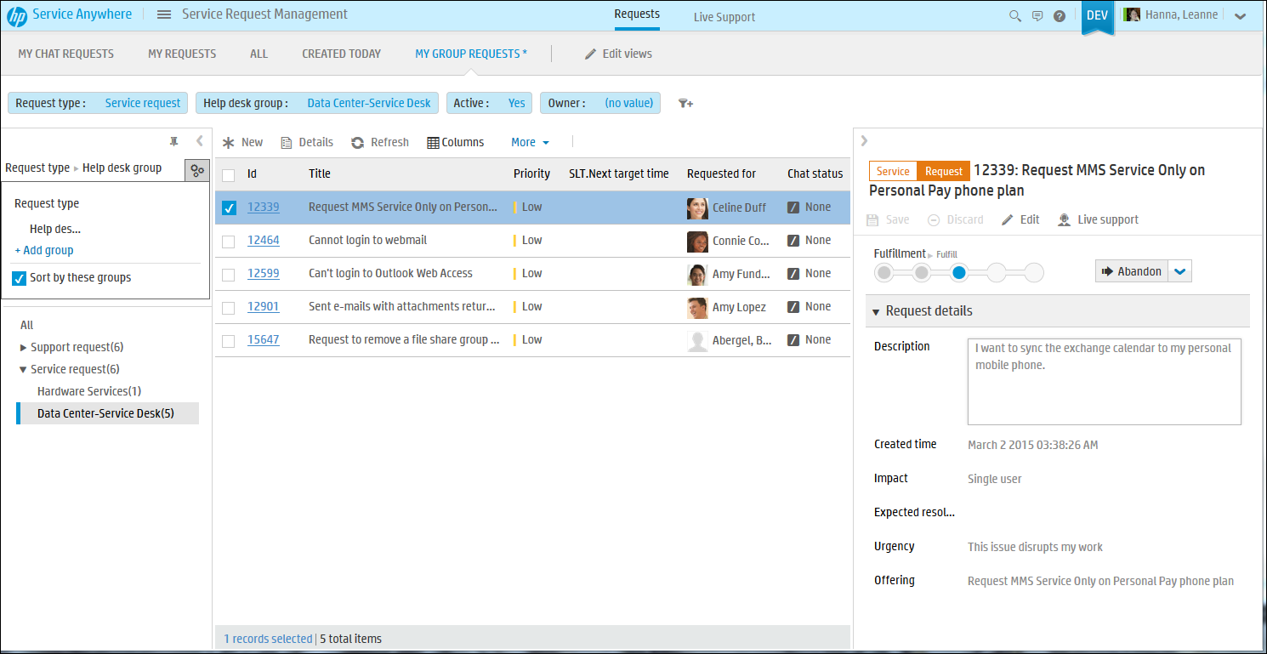
Record List Layout
Provides a consistent navigation user interface across applications
Service Management
Views and Filters
Provides a consistent navigation user interface across applications
Action Toolbar
Record List
List Grouping (pin open or hide)
Record count
Record preview

Slide 21
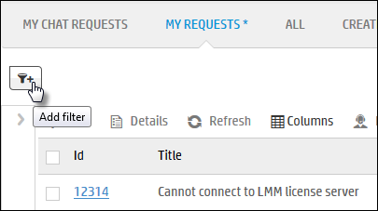
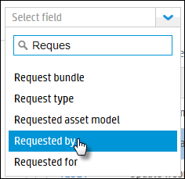
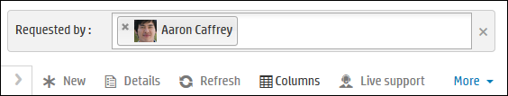
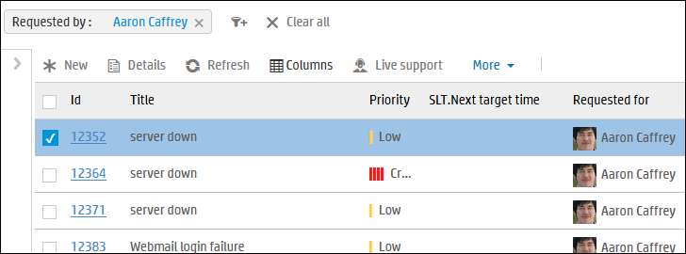
Filtering a List
Alter the list of records by using filters
2. Select the field to filter by
Click Clear all button to remove filter
3. Enter or select values, then click Enter or click away
4. Results from filter will be displayed
1. Click Add filter
5. Click Add filter to add more filters
Notes:
At this stage functions are:
Filtering
Grouping
Presenting (columns)

Slide 22
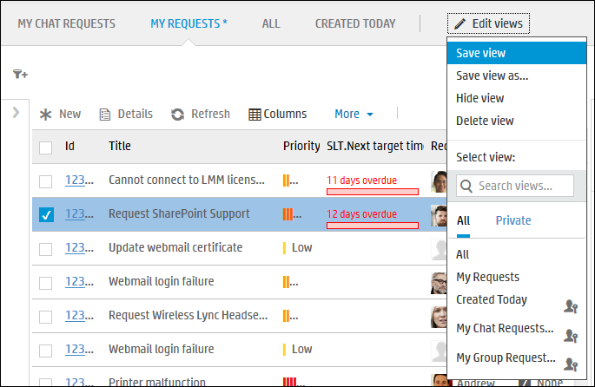
Views
A view is a list of records produced by a search or filter operation.
There are two types of views:
Public – Views that are available to everyone. Some users have access to create public views, but not everyone does.
Private – Views that serve as shortcuts to lists of records you work with regularly. Most users have permissions to create private views.
Notes:
To create a new view:
Create a filter to produce a list of records.
At the top of the page, click Edit Views
Click Save view or Save view as.
Select Private, or Public if you have permission.

Slide 23

Productivity Features
List Record View
Action Tools
Benefit: Consistent buttons and module specific features
Filtering model instead of form based Query by Example
Benefit: One less screen to navigate (start on the list then filter)
Record Grouping
Benefit: Allows users to group similar records
Record Preview on List
Benefit: View and update extra details with navigating away from the list
Color badging by module
Benefit: quick to differentiate between records in the different modules (without too much color)
List counts
Benefit: Can tell at a glance number of records in list

Slide 24
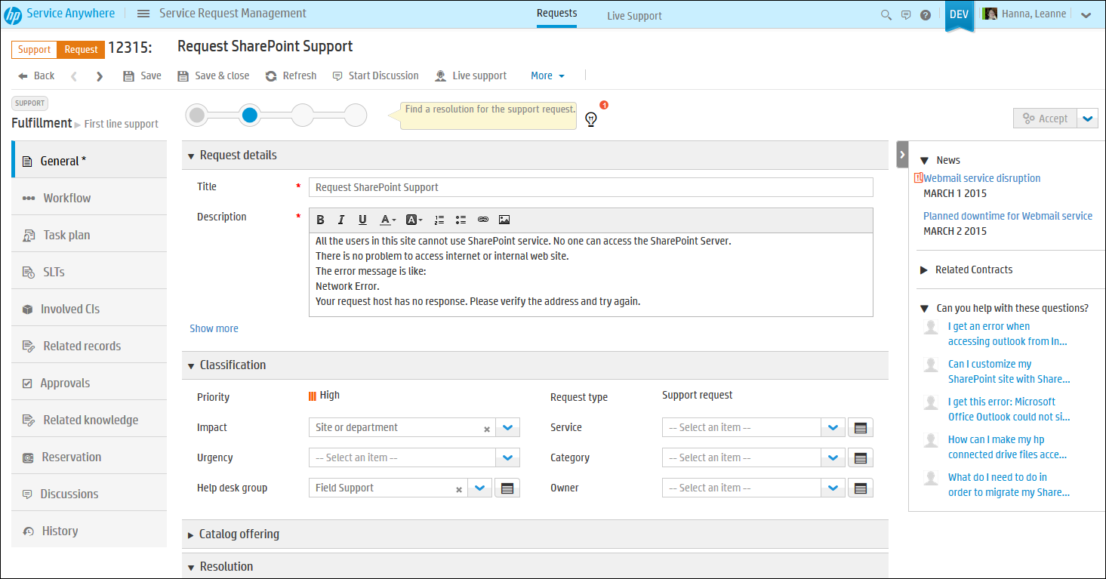
Record Details Layout
Provides a consistent navigation user interface across applications
Service Management
Header
Action Toolbar
Lifecycle widget
Lifecycle widget
Tab content
News, Contracts, Questions
Record tabs

Slide 25
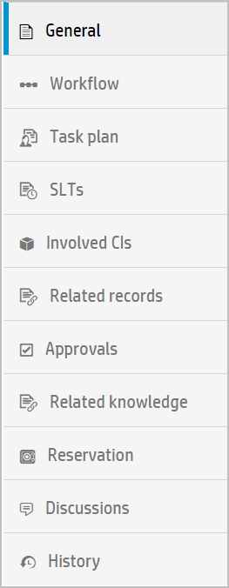
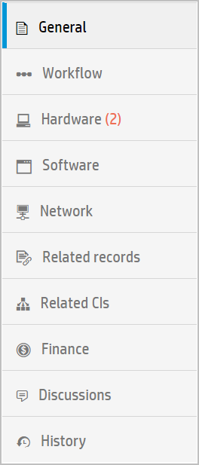
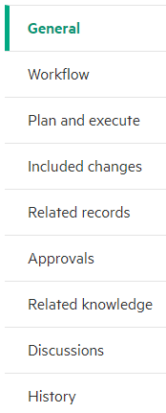
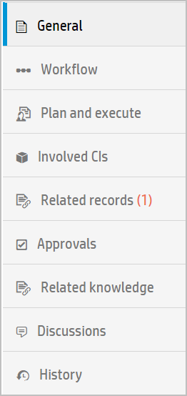
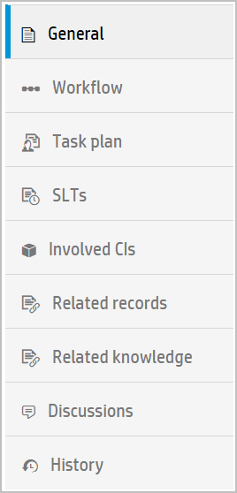
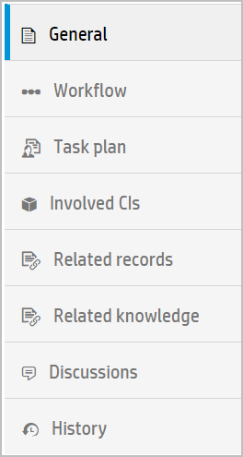
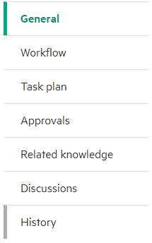
Predefined Tabs
Dynamically change according to record type
Targets
Targets
Request Incident Problem Change Release CIs Knowledge

Slide 26
Productivity Features
Record Detail View
Hierarchical categorization selection widget
Benefit: Much quicker population of category hierarchy for reporting
Type ahead and case insensitive field population
Benefit: quicker field population
Record change indicators
Benefit: Changes to a record can be seen at a glance (* on the Tab)
Visual indicators to inform and pinpoint action
Benefit: Ensure validation and modifications are visible
Tabs and Sections
Benefit: Navigate easily to get the information needed
Metaphases and Lifecycle Widget
Benefit: Quick view of the current state of the record in it’s lifecycle along with quick access context appropriate lifecycle actions
Record counts for attachments, related records, related CIs
Benefit: Can tell at a glance if the tab contains data

Slide 27
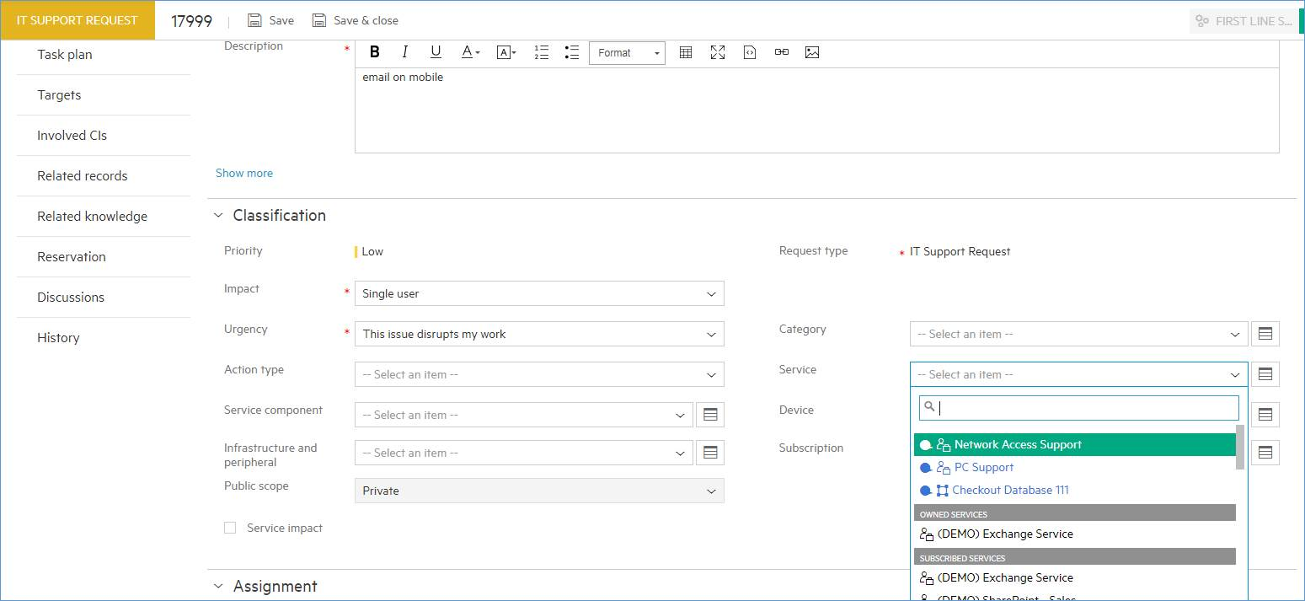
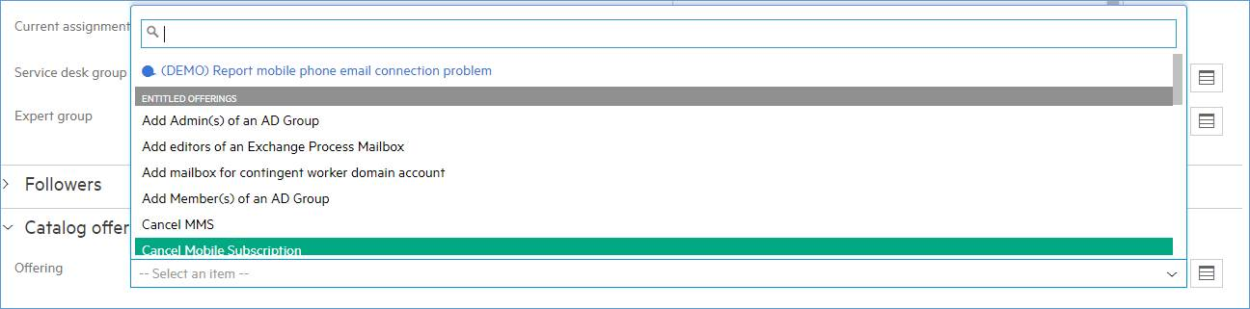
Smart suggestions for Service and Offering

Slide 28
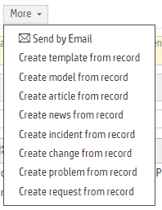
Relationships between Records
Add relationships with More menu on Record Details or Add button on Related Records tab
 | Request | Incident | Problem | Change | Release | Other
Offering | Create Support Request from Support Offering Create Service Request from Service Offering
Request |  | Create Incident from Request |  | Create Change from Request |  | Create article, idea
Incident | Create Request from Incident | Create Incident from Incident | Create Problem from Incident | Create Change from Incident |  | Create article, news
Problem |  |  |  | Create Change from Problem |  | Create article, news
Change |  | Create Incident from Change |  | Create Change from Change Clone Change | Create Release from Change | Create article, news, project, program
Notes:
Create Incident from Request is available from the Action toolbar and the More menu option
Relationships between objects can also be added from the Related records tab

Slide 29
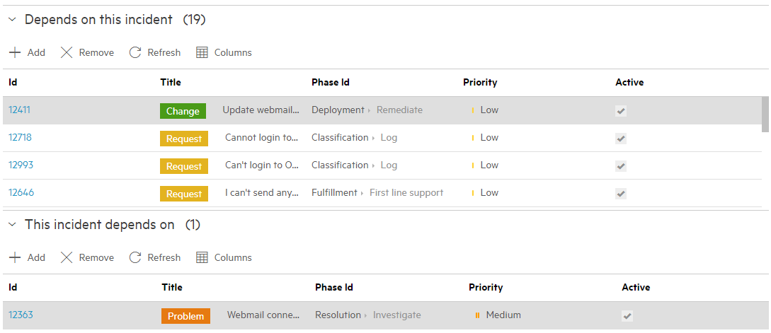
Related Records tab
Two types of relationships
Causes of the record are other events that triggered the current record.
Effects of the record are other events that are the result of the current record.

Slide 30
Task Plans and Approvals

Slide 31
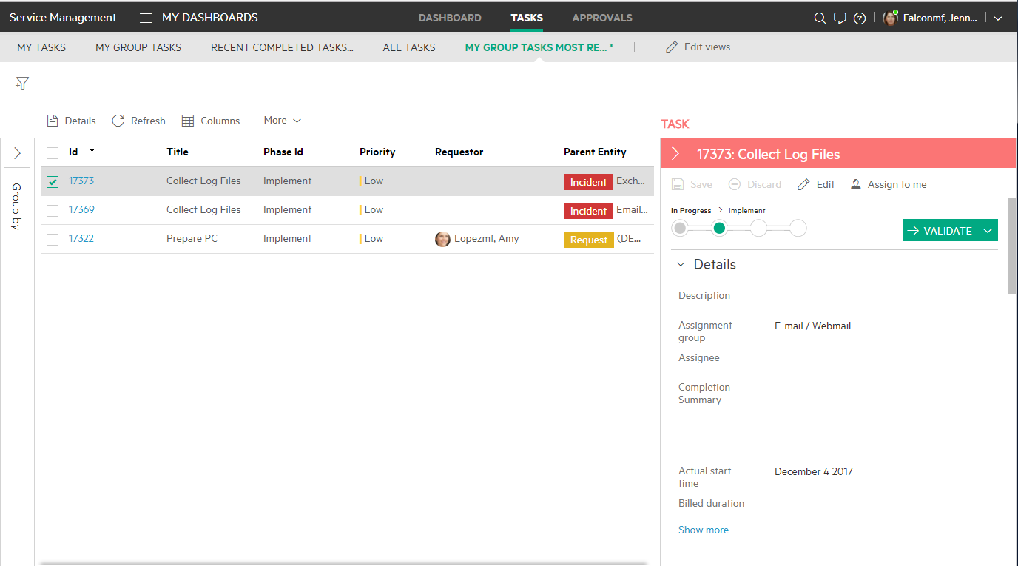
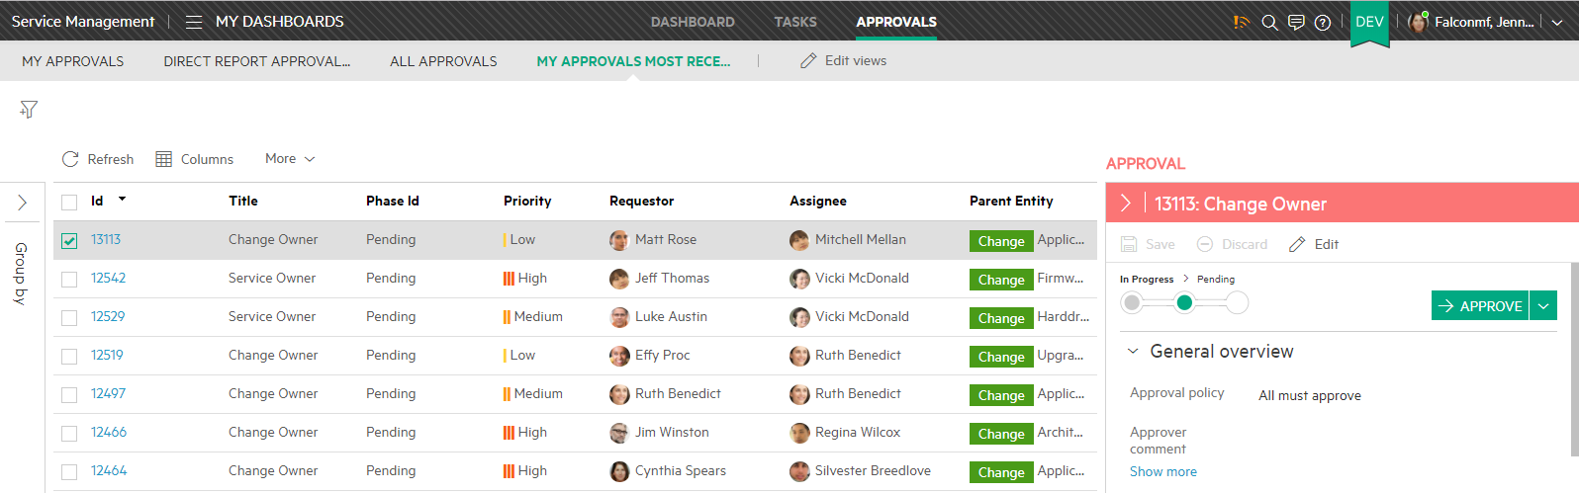
Tasks and Approval Inboxes
Unified tasks TODO list
Task Inbox
Integrated work management with unified TODO list
Preview of the task and its parent record
Agent can view tasks directly in the task execution view
Approvals Inbox
See your approvals or approvals assigned to your employees (if you are a manager)
Tenant admin or manager or role with “override approvals” permission can override approvals
Unified Approvals list

Slide 32
Task Plans
A task plan is a set of tasks in a record's workflow that need to be completed before moving from one phase of the workflow to the next. A task plan might include automated tasks, manual tasks, and decisions that need to be made by the system to determine which path of the task plan to follow.
A task plan for an approval phase of a workflow is known as an approval plan. An approval plan might include approval tasks and decisions that need to be made by the system to determine which path of the approval plan to follow.
You can build task plans for the following record types:
Offerings and fulfillment plans
Service and Support requests
Incidents and incident models
Problems
Changes and change models
Releases and release models

Slide 33
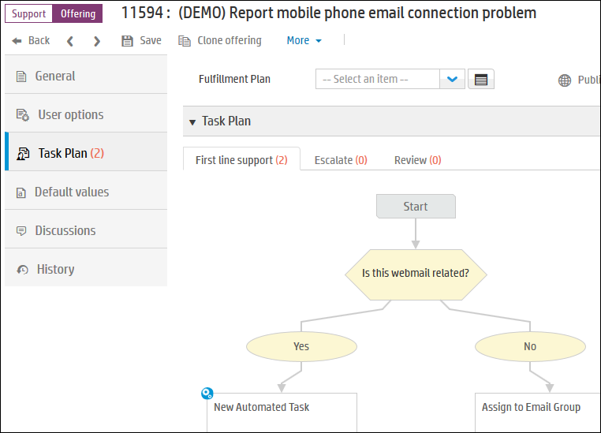
Task Plans
A task plan is defined if you wish to use tasks for the fulfillment of the request.
The task needs to be completed before moving from one phase to the next.
A task plan might include automated tasks, manual tasks, and decisions which are made by the system to determine which path of the task plan to follow.
A Support request have tasks on these three phases
A decision determines which path in plan to follow
Notes:
Task/Approval Plan
A task/approval plan is a set of tasks/approvals in a record's workflow that need to be completed before moving from one phase to the next. A task plan may include automated tasks, manual tasks, and decisions that need to be made by the system to determine which path of the task flow to follow. An approval plan includes approval tasks, and may contain decisions that need to be made by the system to determine which path of the approval plan to follow.

Slide 34
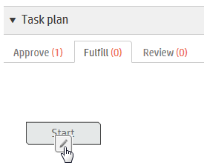
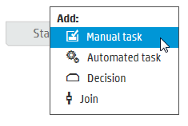
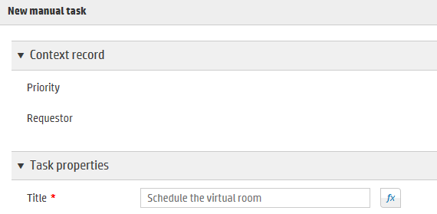
Task Plan – Add a Task
To add a task to the Task Plan, go to the tab where task is to be used:
3. Fill in the Task details and click OK
1. Click the pencil icon
2. Click the type of Task to add
Notes:
A Task Plan can set many fields in the task when it is opened either using Expressions or Text.

Slide 35
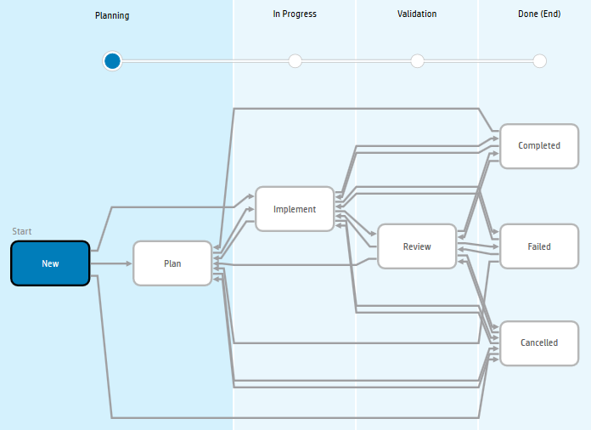
Task Workflow – Manual task

Slide 36

Task Workflow – Automated task

Slide 37


End User Tasks – To Complete a Task
1. Update Task, click Validate
2. Click Save

Slide 38


Completed Request Tasks and Approvals
Tasks are on Task plan tab
Approvals are on Approvals tab

Slide 39

Approval Plan
Approvals are set on the Task Plan’s Approve phase – this is an Approval Plan.
An approval plan might include approval tasks and decisions which are made by the system to determine which path of the approval plan to follow.
A Service request has approvals on Approve phase
Tasks can be added on the other phases
The first approval must be approved before the second approval can be actioned
Notes:
Task/Approval Plan
A task/approval plan is a set of tasks/approvals in a record's workflow that need to be completed before moving from one phase to the next. A task plan may include automated tasks, manual tasks, and decisions that need to be made by the system to determine which path of the task flow to follow.
An approval plan includes approval tasks, and may contain decisions that need to be made by the system to determine which path of the approval plan to follow.
An approval requires one or more users to grant an approval before the workflow can move on to the next phase.

Slide 40



Approval Plan – Add an Approval
To add an approval, go to the Approve tab in the Task plan:
1. Click the pencil icon
2. Click Approval
3. Choose a User, Group or Expression to set the approver
Notes:
Approval Plan Fields

Slide 41


Approval Strategy
Approval Strategy
All must approve
All must approve – immediate deny
Quorum
One must approve
One must approve – immediate deny
BU manager approve
Notes:
Approval Strategy
An approval requires one or more users to grant an approval before the workflow can move on to the next phase.
Approval Strategy is the strategy used to obtain the approval:
All must approve - Every assigned user must grant an approval.
All must approve - immediate deny – Every assigned user must grant an approval. If one user denies an approval, the approval is denied.
Quorum – The majority of responses determines whether the approval is granted or denied.
One must approve – Requires only one assigned user to grant an approval. The approval is granted regardless of the responses of the other users.
One must approve – immediate deny – Requires only one assigned user to grant anapproval. If one user denies an approval, the approval is denied. (The decision follows the first user who answers.)

Slide 42



Executing Approvals
Approvals can be made:
IT Agent Interface
Self-Service Portal interface or mobile
2. Click Approve then Save
1. Click Approve

Slide 43


Exercises
Self-Service Quick Flow Demo Card
Mobile Quick Flow Demo Card

